Slide 1
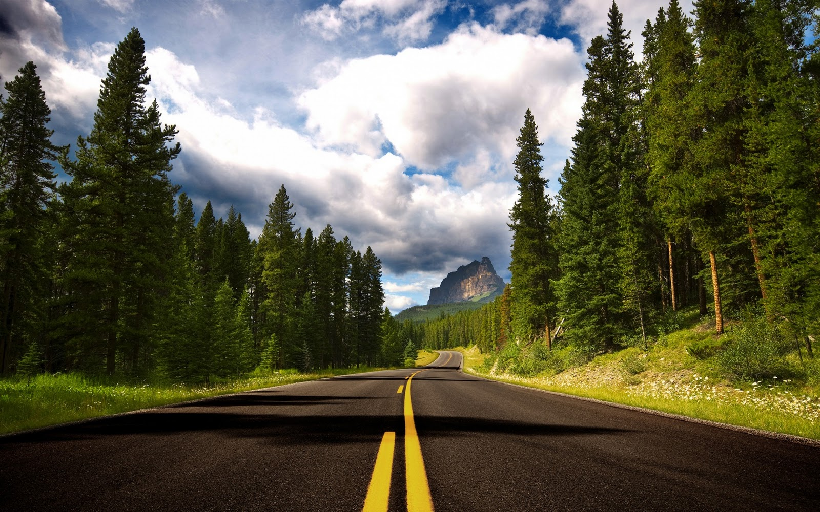
Comprehensive Analysis of Road Congestion in Greater Mumbai
Consulting & Analytics Club, IIT Guwahati
Team Members:
Meda N V S S Balaji Punith Kumar
Rahul Katam
Shettigari Sathwik Chadra
Jatavath Arjun Kumar
National Institute of Technology, Warangal

Slide 2
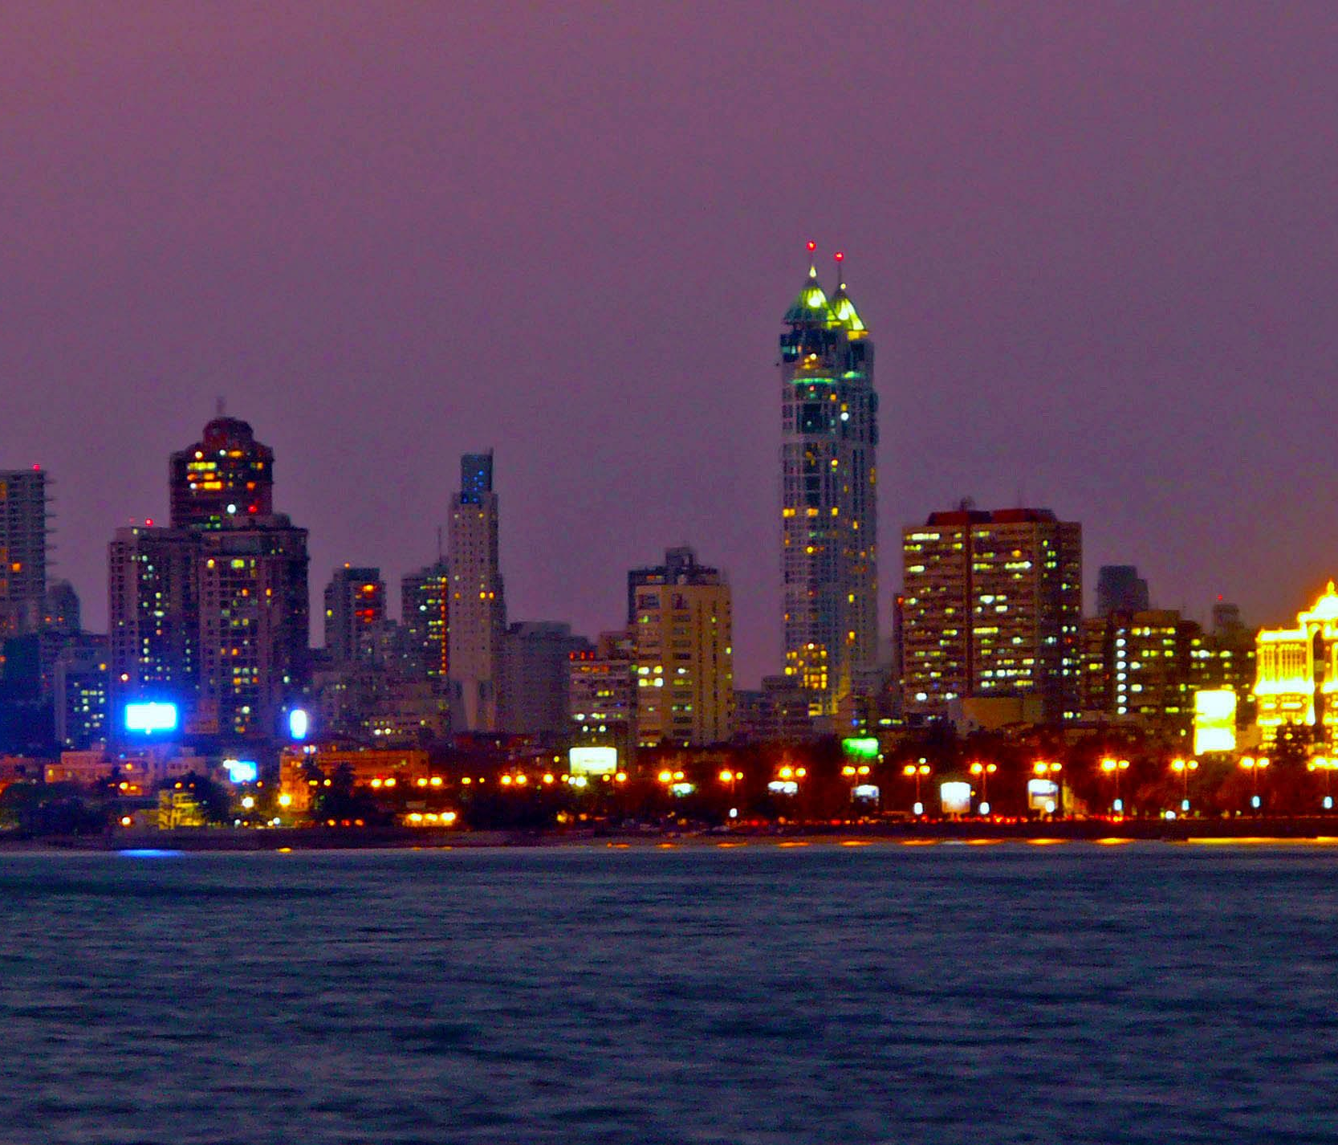

Introduction
Greater Mumbai faces severe road congestion, significantly impacting residents' quality of life and the city's economic efficiency. The Municipal Corporation of Greater Mumbai (MCGM) seeks to address these challenges through a detailed study aimed at developing actionable recommendations for immediate and long-term improvement of urban mobility.

Slide 3
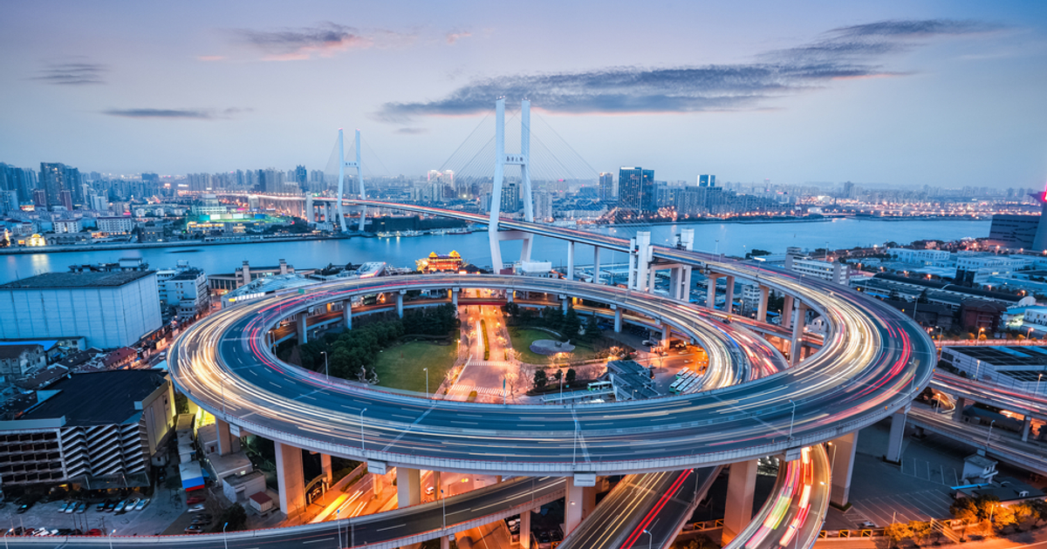
Objectives
1.Analyze Current Road Congestion:
We have to understand the extent, causes, and impacts of road congestion.
2. Propose Actionable Recommendations:
We need to suggest both supply-side (infrastructure improvements) and demand-side (traffic management) interventions.
3. Explore Innovative Solutions:
We have to evaluate future-oriented strategies such as dynamic congestion pricing and new transportation modes.

Slide 4
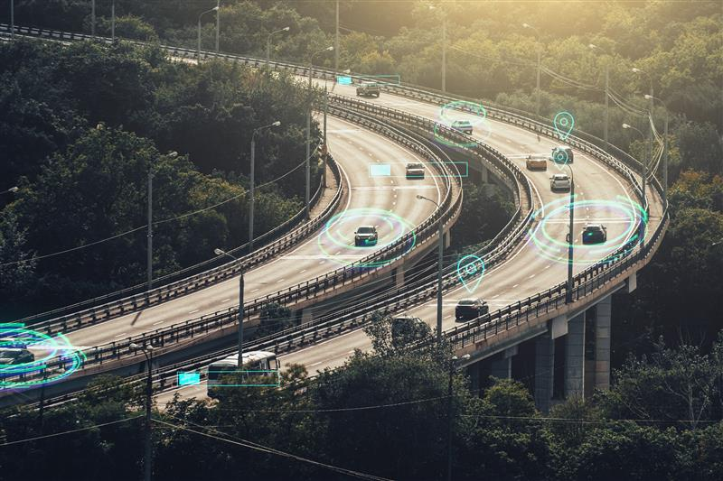
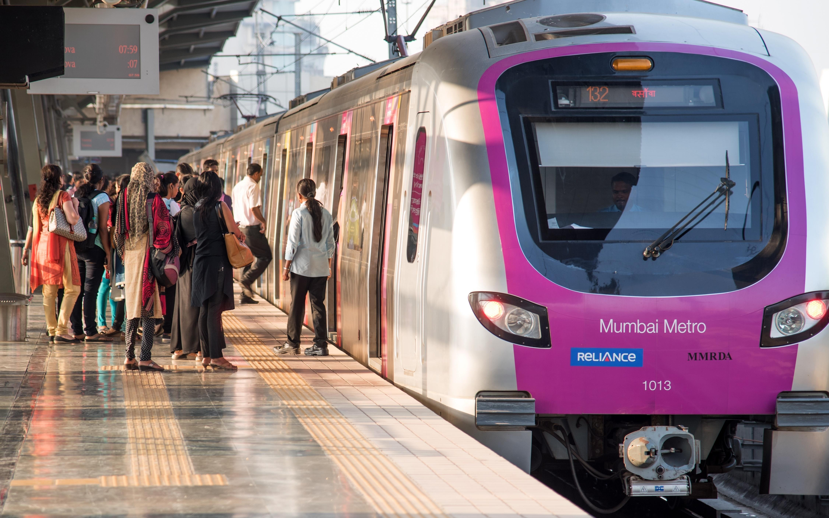
Things to Consider - Road Congestion
Traffic Analysis :
Traffic Volume: Collect data on daily traffic volumes on major roads and intersections.
Travel Time and Speed: Analyze average travel times and speeds during peak and off-peak hours.
Congestion Hotspots: Identify key congestion hotspots and analyze the reasons for bottlenecks.
Public Transport :
Capacity and Usage: Evaluate the capacity and current usage levels of public transport systems.
Service Quality: Assess the frequency, punctuality, and coverage of public transport.
Non-Motorized Transport :
Infrastructure: Review the availability and quality of pedestrian pathways and cycling lanes.
Usage Patterns: Study the usage patterns of non-motorized transport options.

Slide 5
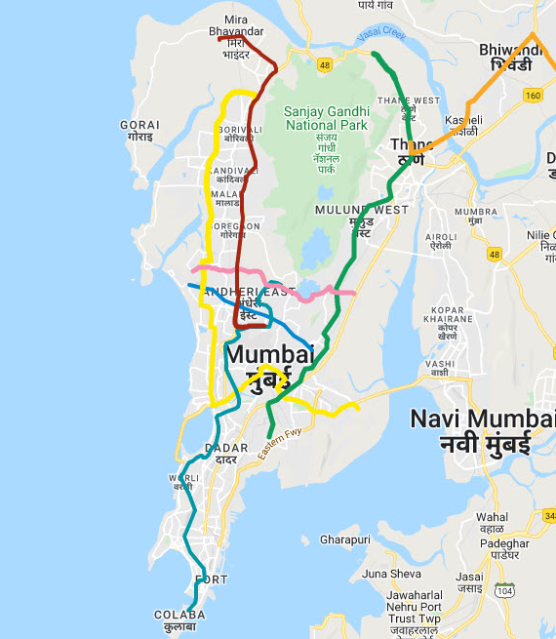

Estimation - Metro Trains in Greater Mumbai
The following assumptions are in order to calculate the no. of metro trains in Greater Mumbai, India:
Greater Mumbai has a population of around 20 million people.
As of the latest updates, the operational lines are about 50 kilometers long.
For Mumbai, let’s assume an average frequency of a train every 5 minutes during peak hours. (12 trains per direction)
Assume, a metro line operates for 18 hours a day.
In Mumbai, trains generally have 4 to 6 cars per train.
A train's average speed (including stops) is about 30km/h.
Let’s consider 3 main operational lines in Greater Mumbai.
Final Estimate:
There are approximately 130 to 150 metro trains operating in Greater Mumbai.

Slide 6
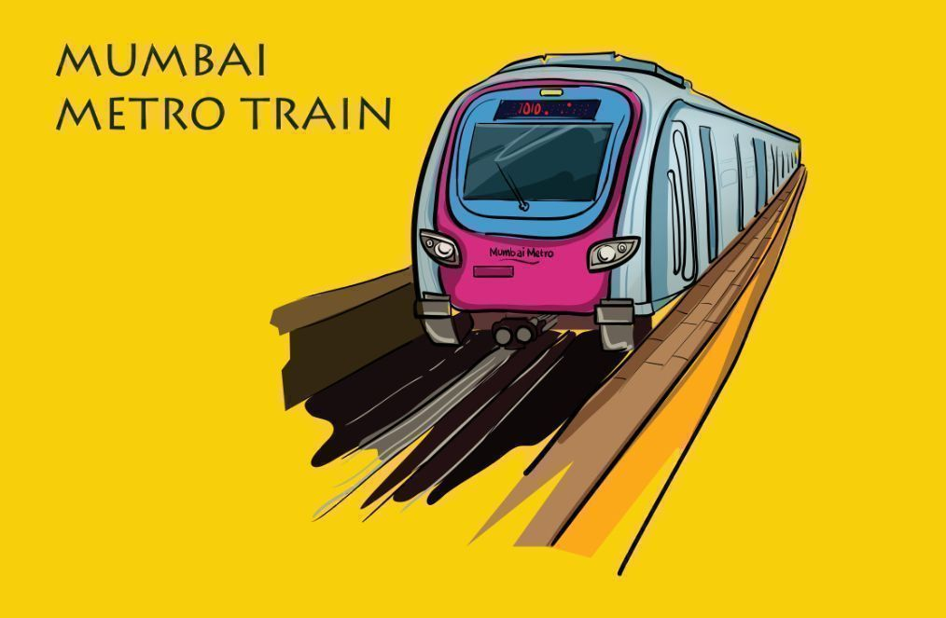
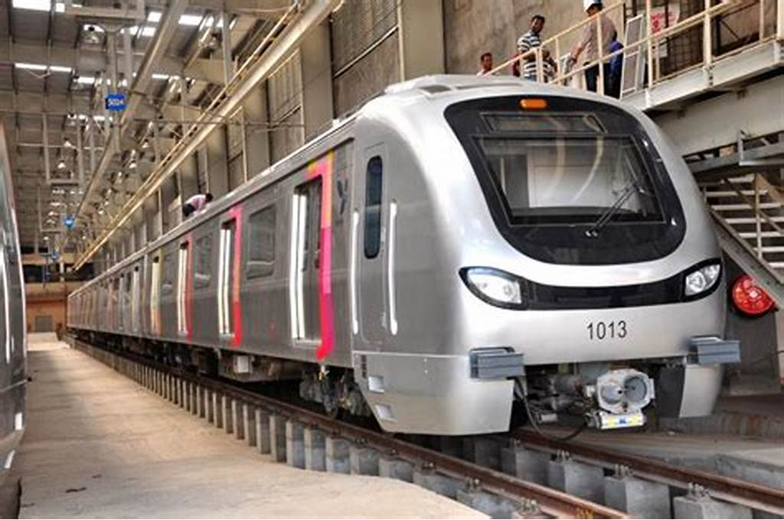
Step-01: Greater Mumbai has a
population of around 20 million people.
Step-02: The operational lines are
about 50 kilometers long.
(Line1, Part of Line 2, Line 7)
Step-03: Let's assume an average frequency of a train every 5 minutes during peak hours.
(Hence, 12 train per hour per direction)
Step-04: Assuming a metro line operates for 18 hours a day (from morning to night)
12 trains/hour × 18 hours × 2 directions
= 432 train trips per day per line
Step-05: A train travels with an average speed of 30km/h, a single trip takes about 50km
divided by 30km/h i.e, 1.67 hours.

Slide 7
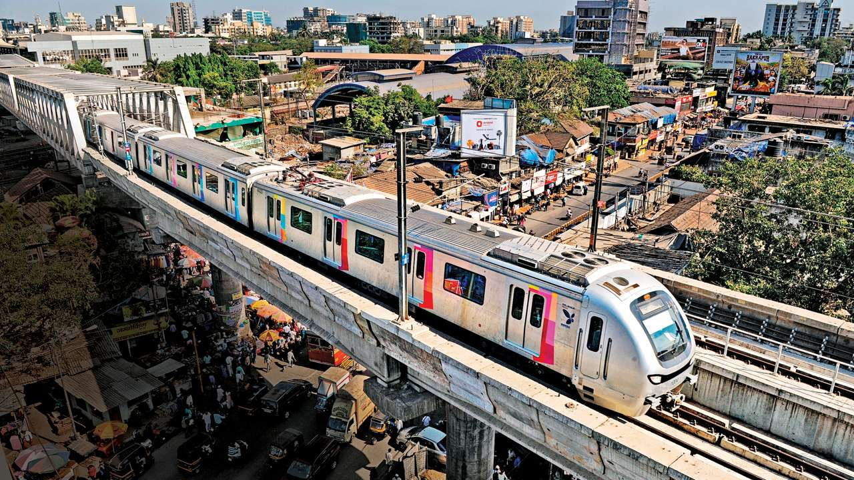
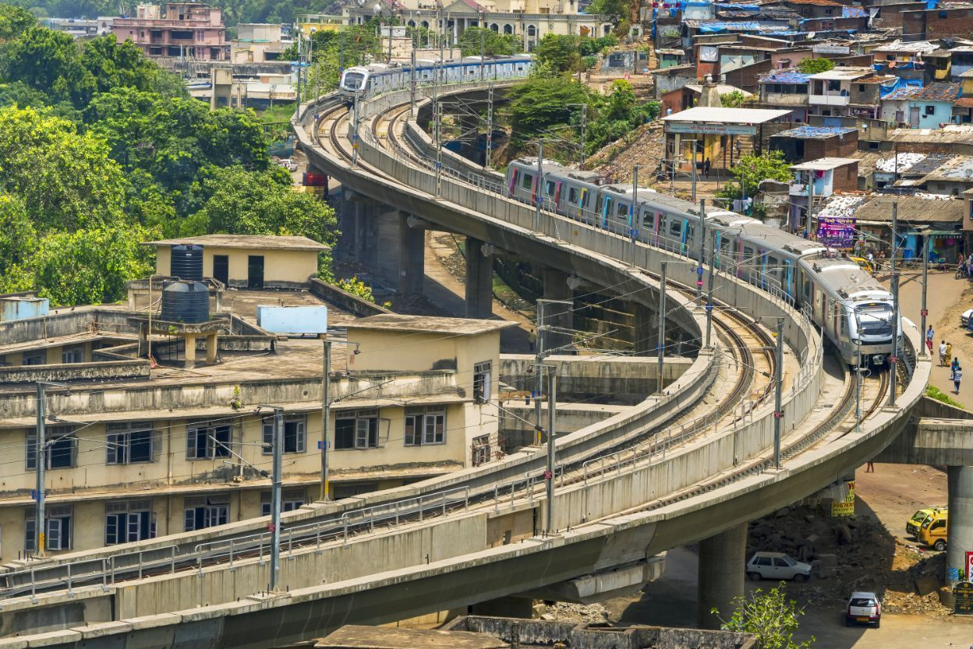
Step-06: Therefore, each train can make about 18hours/1.67 hours = 10 trips a day.
Step-07: If there are 500 train trips needed per day, we need about 500 trips / (10 trips/train ) = 50 trains
Step-08: Let’s consider 3 main operational lines in Greater Mumbai. Therefore, for 3 lines, we would need 50 * 3 lines = 150 trains
Step-09: There are approximately 130 to 150 metro trains operating in Greater Mumbai, considering the current extent of the metro network and typical operational parameters.

Slide 8
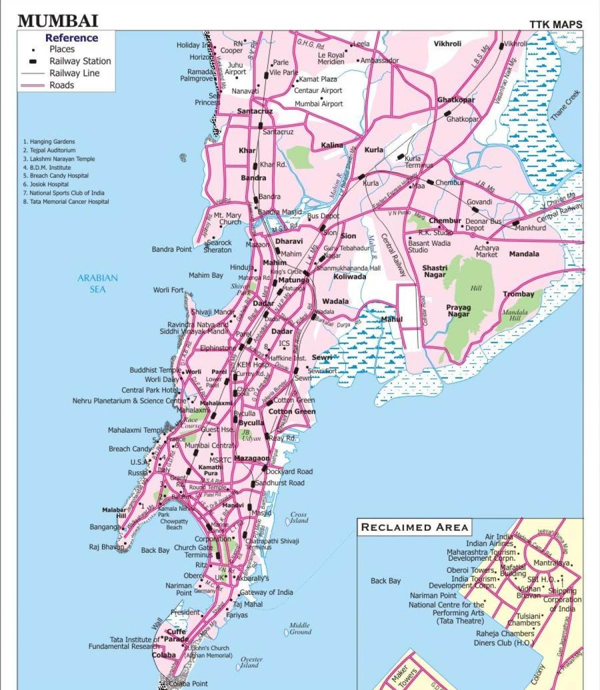
Estimation - Public Buses in Greater Mumbai
The following assumptions are in order to calculate the no. of public buses in Greater Mumbai, India:
Greater Mumbai has a population of around 20 million people.
Let's assume around 50% of the population uses public transport daily.
Of these, a considerable portion uses buses. Let’s estimate around 30% use buses, given the extensive local train network also serving the city.
An average bus capacity is about 50 passengers.
Assume, an average bus makes about 10 trips per day.

Slide 9
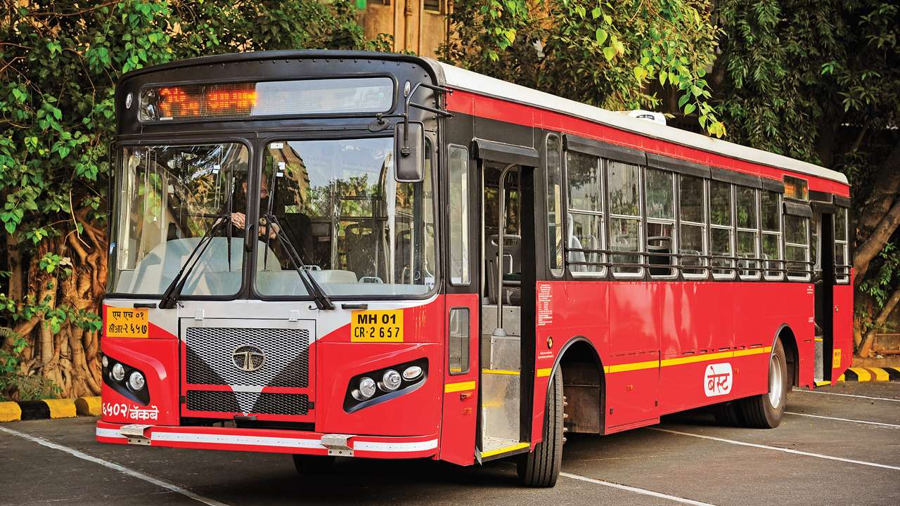
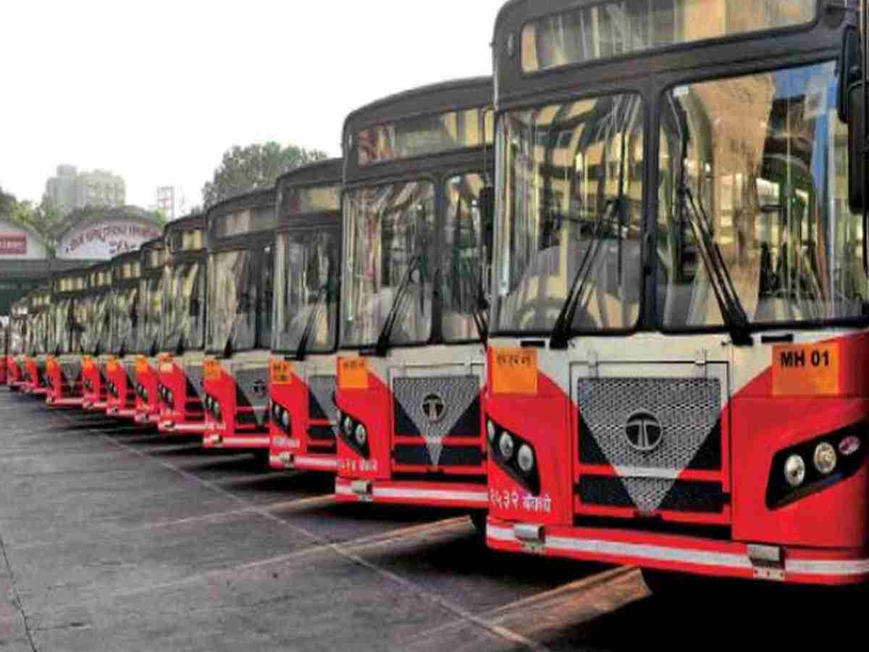
Step-01: Greater Mumbai has a
population of around 20 million people.
Step-02: Let's assume around 50% of the population uses public transport daily.
30% of these 50% people use buses,
given local train network also serving the city.
Step-03: Calculate Daily Bus Commuters:
Daily Public Transport Users: 20M * 50% = 10M
Daily Bus Users: 10M * 30% = 3M
Step-04: Assume, an average bus
makes about 10 trips per day and
has a capacity of 50 passengers.
Step-05: No. of buses: 3M / 50/bus = 6000 buses
There are approximately 6000 buses
operating in Greater Mumbai, India.

Slide 10






Estimation - Traffic Volume & Density (Python & Excel)
A detailed traffic volume data analysis is performed by using python and excel and the following insights are obtained. Here's an extent of road congestion in Greater Mumbai in terms of travel time and speed:
High Traffic Volume: Mumbai has one of the highest traffic volume in India, with around 1,800 vehicles per hour at a section of a road. This high traffic volume significantly contributes to congestion.
Vehicle Growth Rate: The number of registered vehicles in Mumbai has been growing at a rate of approximately 6-8% per year. This increase puts additional strain on the already congested roads.

Slide 11

Assumptions & Code - Traffic Volume Data
A python code is written to estimate the no. of vehicles in peak hour in terms of Passenger Car Unit (PCU) and Peak Hour Factor (PHF).
Passenger Car Unit (PCU): A Passenger Car Unit (PCU) standardizes traffic flow by converting various vehicle types into equivalent car units for analysis.
Peak Hour Factor (PHF): The Peak Hour Factor (PHF) measures how traffic volume fluctuates within an hour. It's calculated by dividing the total hourly traffic by four times the peak 15-minute traffic.
The following assumptions are shown in the given table in writing the code:
GitHub Repository Link:
Traffic Data Analysis
Time Interval | Cars (per 15 min) | Bikes (per 15 min) | Buses (per 15 min) | Autos (per 15min) | Trucks (per 15min)
05:30 - 08:00 | 50 - 75 | 50 - 75 | 10 - 15 | 20 - 30 | 0 - 10
08:00 - 11:00 | 200 - 250 | 200 - 250 | 10 - 15 | 40 - 50 | 0 - 10
11:00 - 16:00 | 100 - 150 | 100 - 150 | 10 - 15 | 30 - 40 | 0 - 10
16:00 – 21:00 | 200 - 250 | 200 - 250 | 10 - 15 | 40 - 50 | 0 - 10
21:00 - 23:00 | 50 - 75 | 50 - 75 | 10 - 15 | 20 - 30 | 0 - 10
Explanation: From 05:30 - 08:00, the no. of cars traveling on a particular section of the road are 50 to 75 for an time interval of 15 minutes.

Slide 12


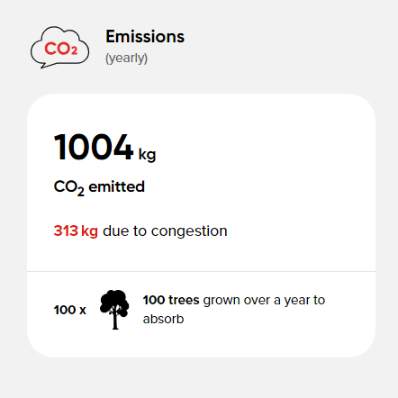

Travel Time & Speed - Road Congestion
The TomTom website, provides information about travel time and speed of vehicles in Greater Mumbai, India.
Here's an extent of road congestion in Greater Mumbai in terms of travel time and speed.
Peak Hour Delays: During peak hours, average travel speeds drop to as low as 10-15 km/h in many parts of the city. In severe cases, speeds can drop even further, leading to substantial delays.
Average Commute Time: The average daily commute time in Mumbai is around 2 hours, significantly higher than the national average. Commuters often experience long delays due to traffic congestion.

Slide 13
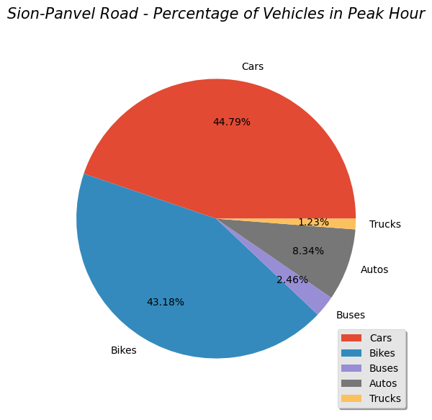

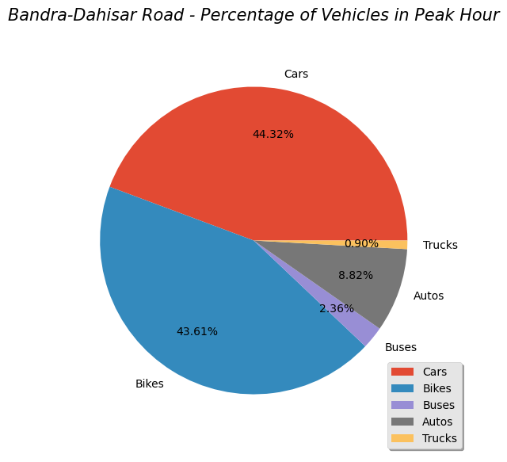
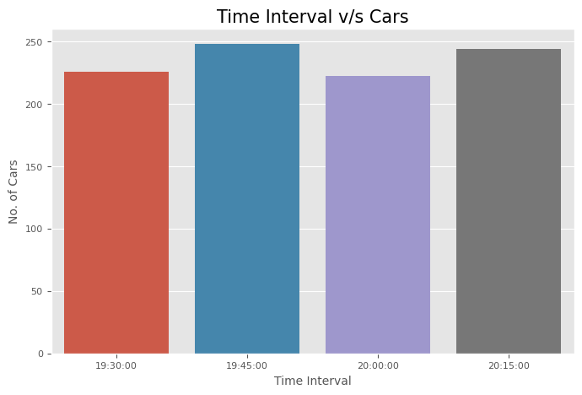
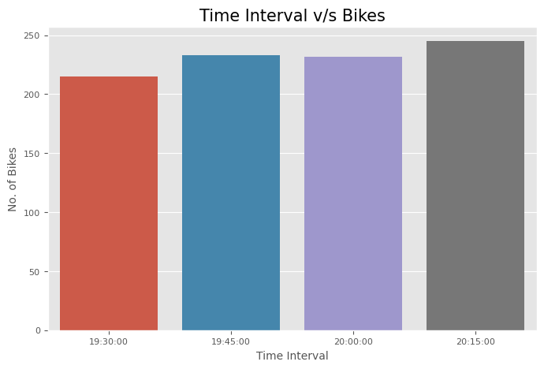
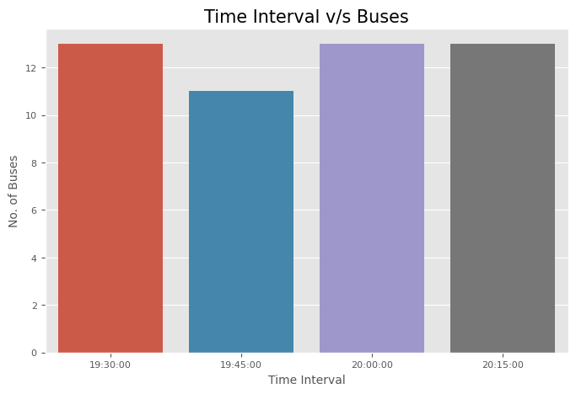
Dashboards / Charts – Traffic Volume Analysis
Pie Plots: The pie charts represents the percentage of different vehicles in the peak hour time period.
Bar Plots: The bar plots represents the count of a particular vehicle in 15 minute intervals of the peak hour.

Slide 14
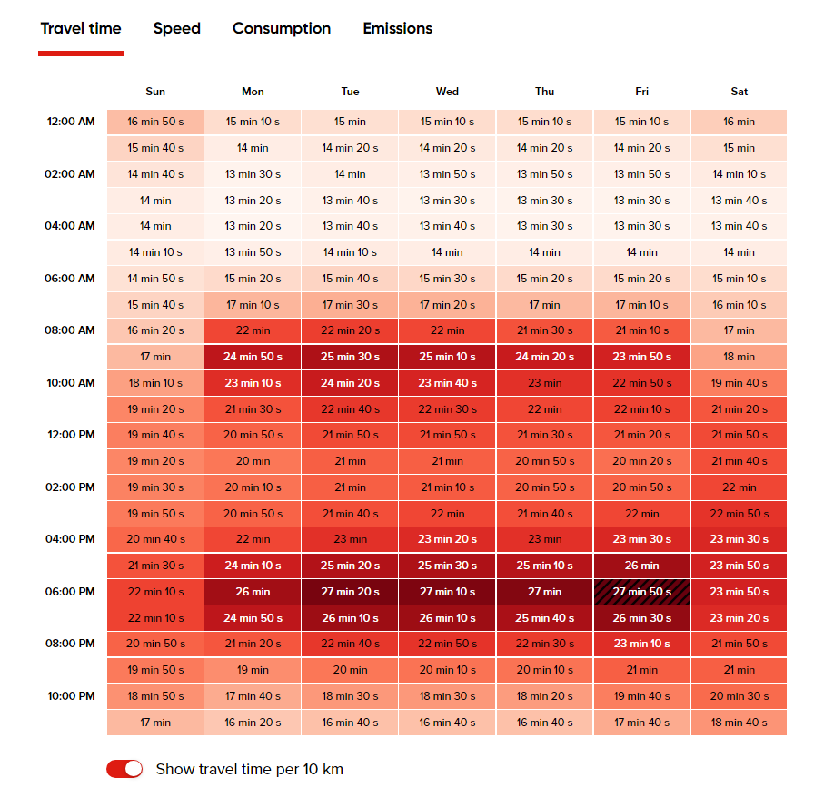
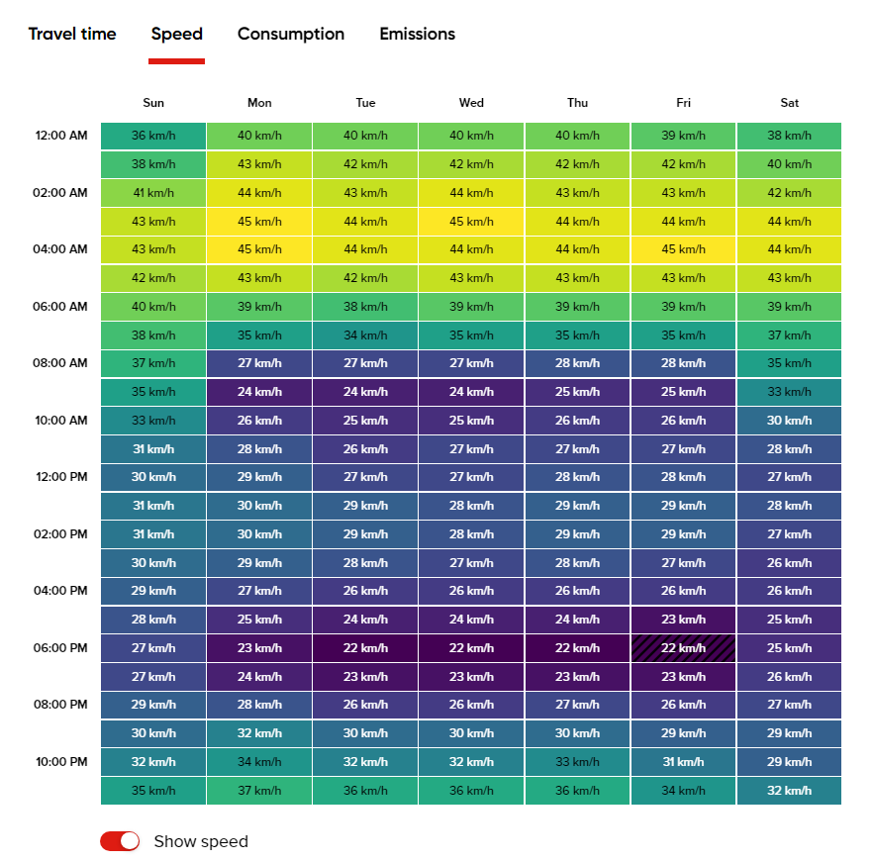
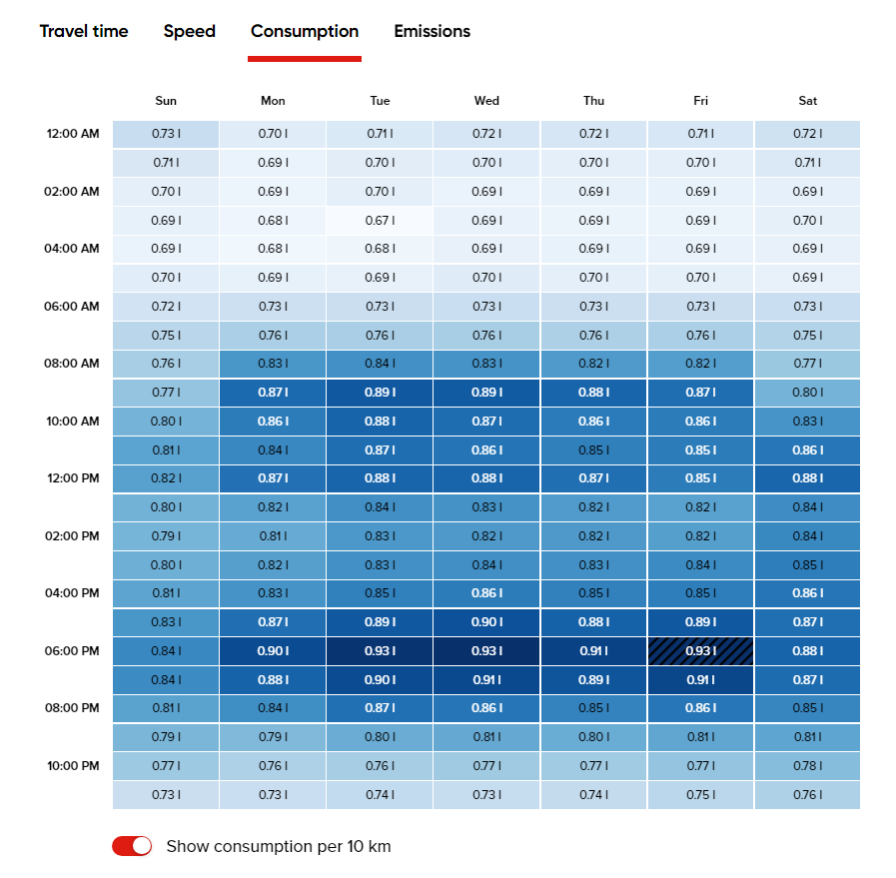
Charts / Heatmaps - Travel Time & Speed
Heatmaps: The following heatmaps gives an idea at what day and time the travel time and consumption of fuel is maximum.
Travel Time: Avg. Time taken to travel 10km at a particular day and time.
Speed: Avg. Speed of the vehicles at a particular day and time.
Consumption: Avg. Fuel consumption of vehicles at a particular day and time.

Slide 15
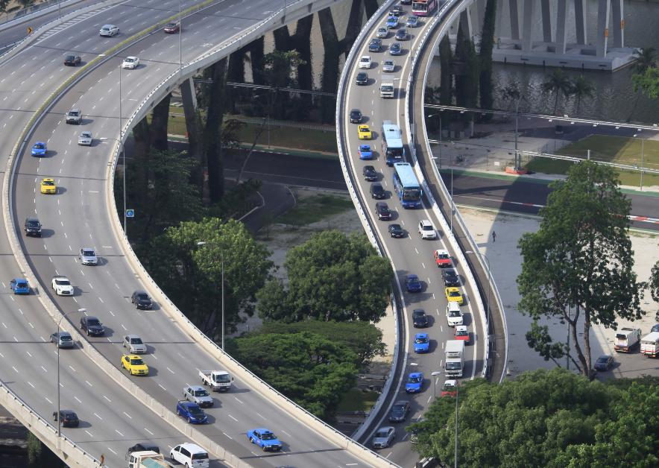
Estimation of Congestion Hotspots
The key areas for road congestion and the reasons for them include:
Key Areas: Major congestion hotspots include areas such as Andheri, Dadar, Sion, and the Eastern and Western Express Highways. The peak hour volume in these areas is around 1800 vehicles and the peak hour factor is greater than 0.90 in these areas. These areas frequently experience gridlocks during peak hours.
Bottlenecks: Specific bottlenecks such as flyovers, intersections, and narrow road segments are major contributors to traffic jams. For example, the Sion-Panvel Expressway and the Western Express Highway are known for severe bottlenecks.

Slide 16
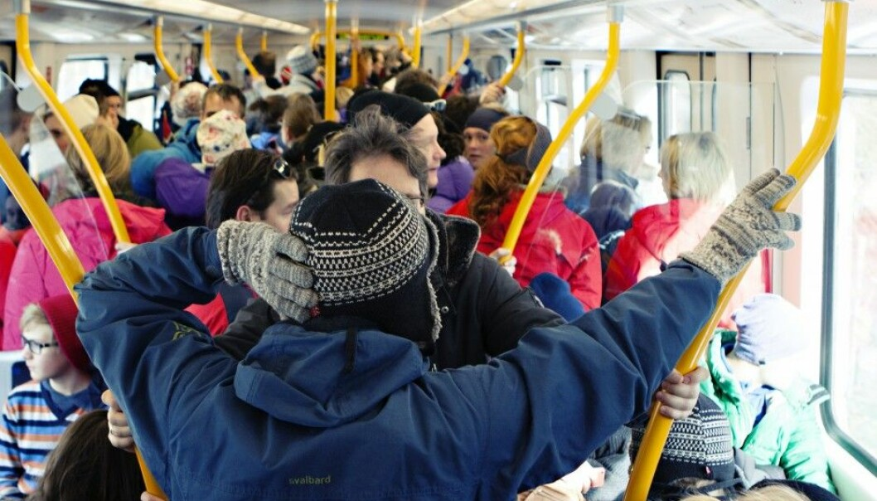
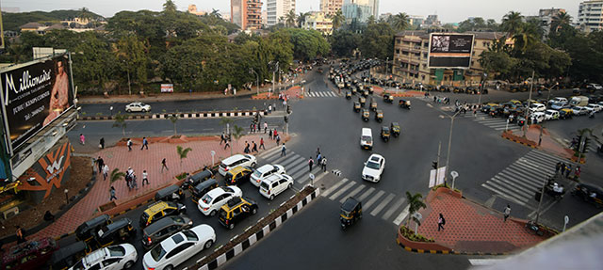
Estimation of Capacity - Public Transport – Road Congestion
The overcrowded trains and buses, insufficient infrastructure are also some of the important reasons for road congestion in Greater Mumbai, India.
Here's an overview about them:
Overcrowded Trains and Buses: Mumbai’s local trains and buses operate at over 150% capacity during peak hours. This overcrowding results in delays and reduces the efficiency of public transport.
Insufficient Infrastructure: There is a lack of sufficient infrastructure to support the growing number of public transport users. Limited seating capacity, poor maintenance, and infrequent services contribute to the congestion.

Slide 17
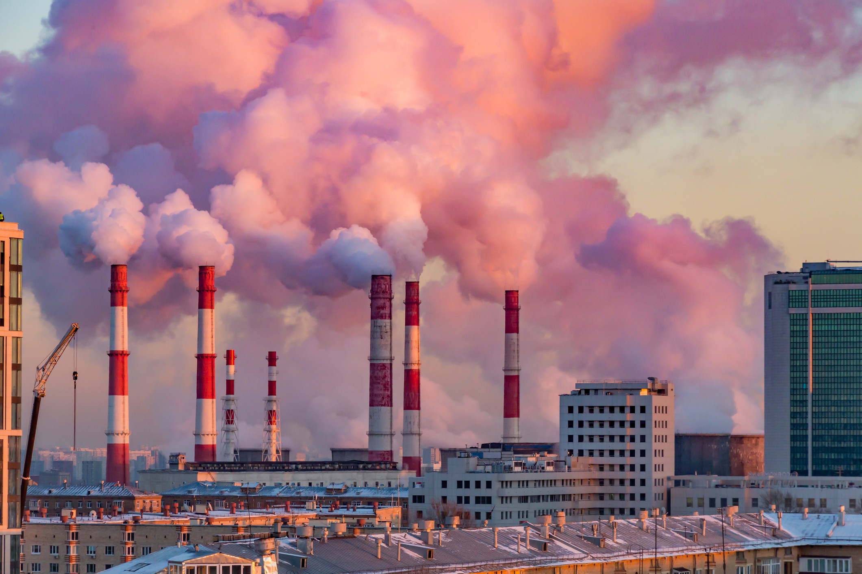
Estimation of Air Quality Index (AQI) - Road Congestion
The following are the impacts of the road congestion:
Air Pollution: The high level of vehicular emissions contributes to severe air pollution. Mumbai often records air quality index (AQI) levels in the 'moderate' category. The AQI-US of Greater Mumbai is around 69. (Click Here - Air Quality Index)
Health Issues: Increased pollution and longer travel times lead to higher stress levels among commuters and contribute to health issues such as respiratory problems and cardiovascular diseases.

Slide 18
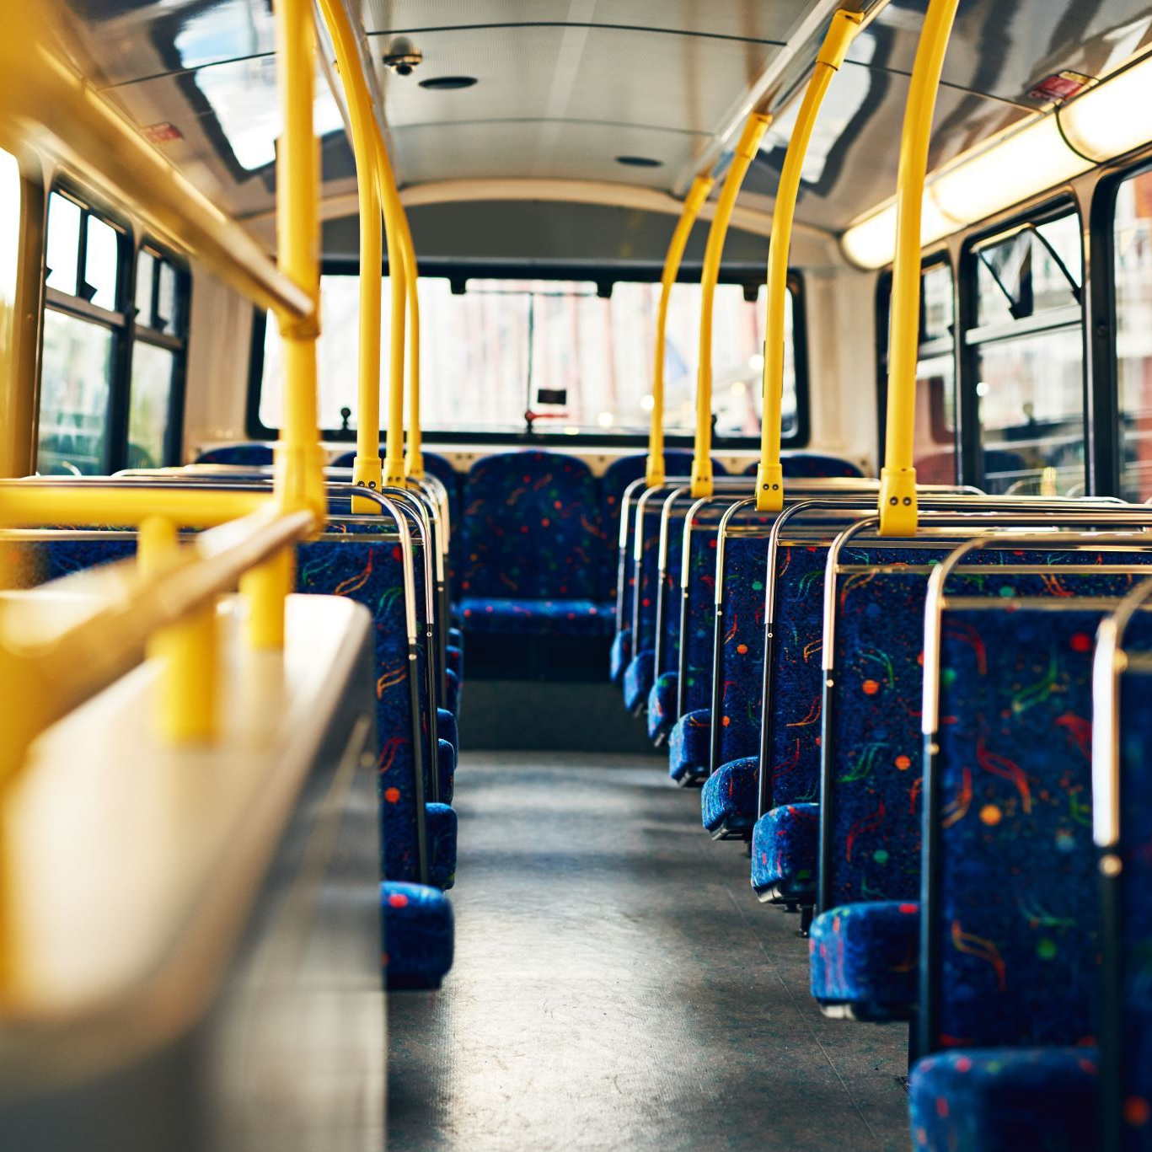
Public Transport System
A public transport system refers to a network of vehicles and infrastructure that provides transportation services to the general public on a regular, scheduled basis. These systems are crucial in urban areas and beyond for moving large numbers of people efficiently and reducing dependence on private vehicles.

Slide 19
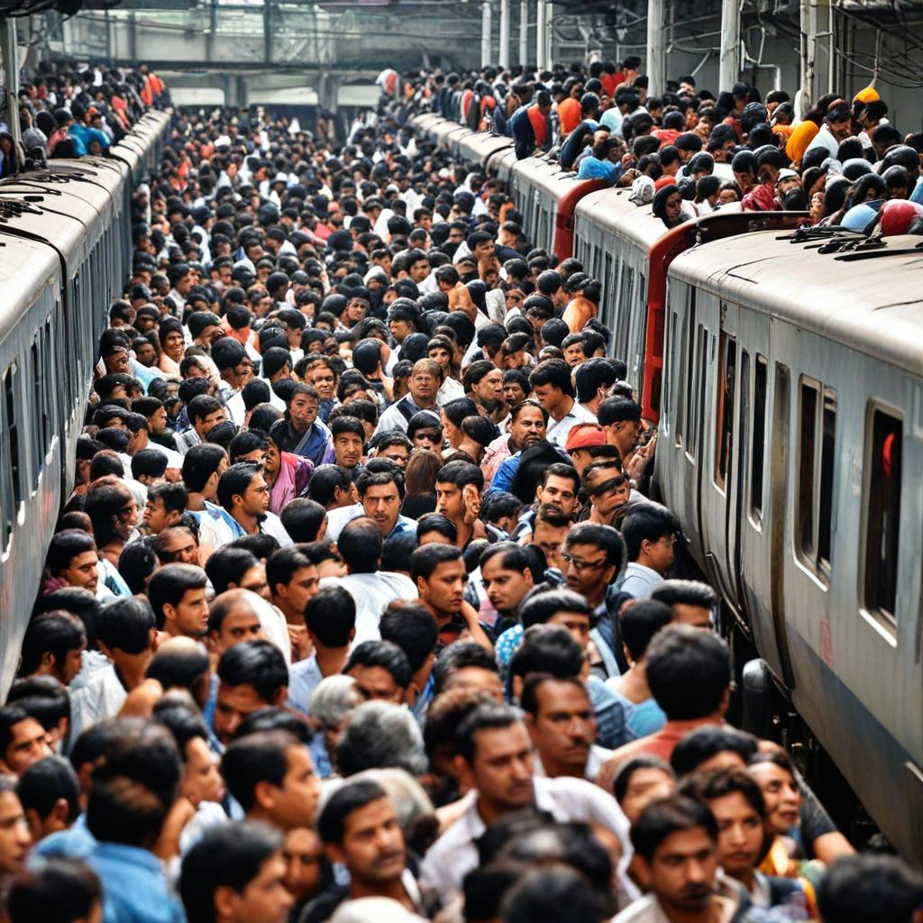
Road Congestion Issues - Poor Public Transport Systesm
The following are the major causes of congestion issues due to public transport system:
Overcrowded Public Transport: Mumbai’s trains and buses are often overcrowded, making them uncomfortable and unreliable, especially during peak hours. This leads to an increased reliance on private vehicles.
Inadequate Coverage and Frequency: Certain areas in Greater Mumbai have limited access to public transport. Infrequent services further discourage usage, pushing more people towards using private vehicles.
Lack of Integration: Poor integration between different modes of transport (trains, buses, metro) results in inefficient transfers and longer commute times, reducing the attractiveness of public transport.
Slow Speeds and Delays: Traffic congestion on roads also affects the speed and punctuality of buses. Trains, though faster, often suffer from delays and overcrowding.

Slide 20
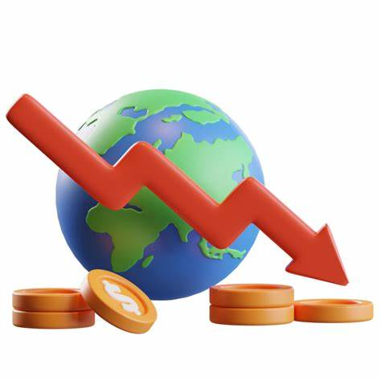
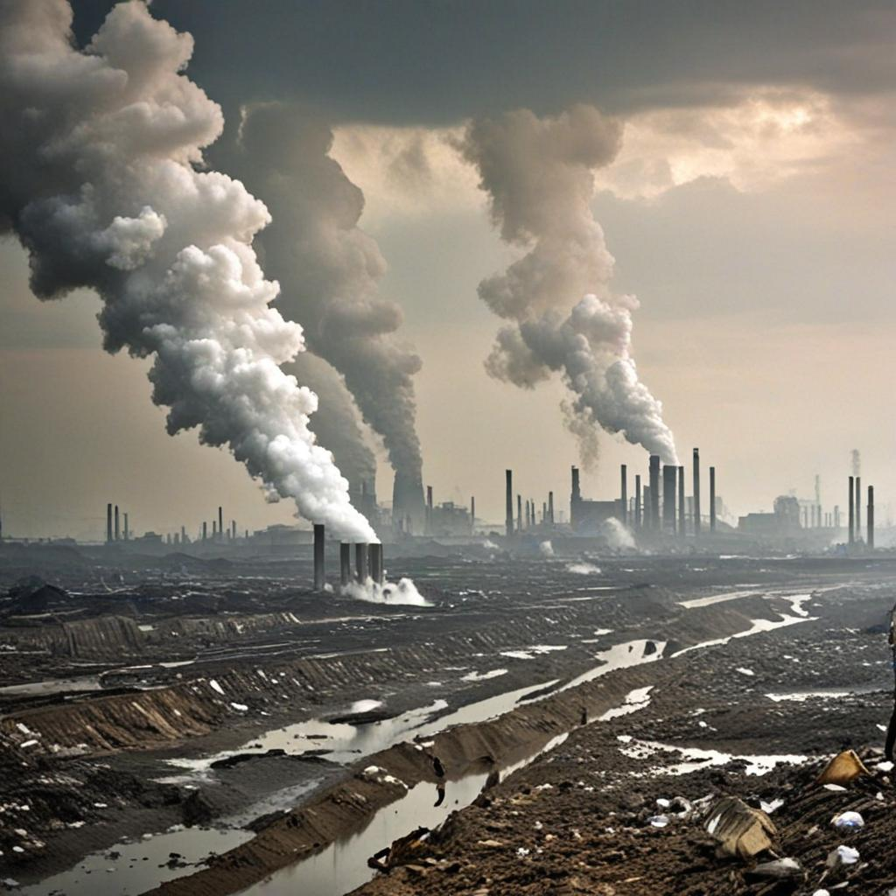
Road Congestion Issues - Poor Public Transport System
The following are the major impacts of congestion issues due to poor public transport system:
Increased Private Vehicle Usage: As public transport becomes less reliable and comfortable, more people opt for private vehicles, leading to higher traffic volumes and congestion.
Higher Emissions: Increased use of private vehicles contributes to higher levels of pollution and greenhouse gas emissions.
Economic Costs: Commuters spend more time and money on travel due to inefficient public transport, affecting productivity and economic growth.
Social Inequity: Poor public transport disproportionately affects lower-income groups who rely more on affordable transport options.

Slide 21
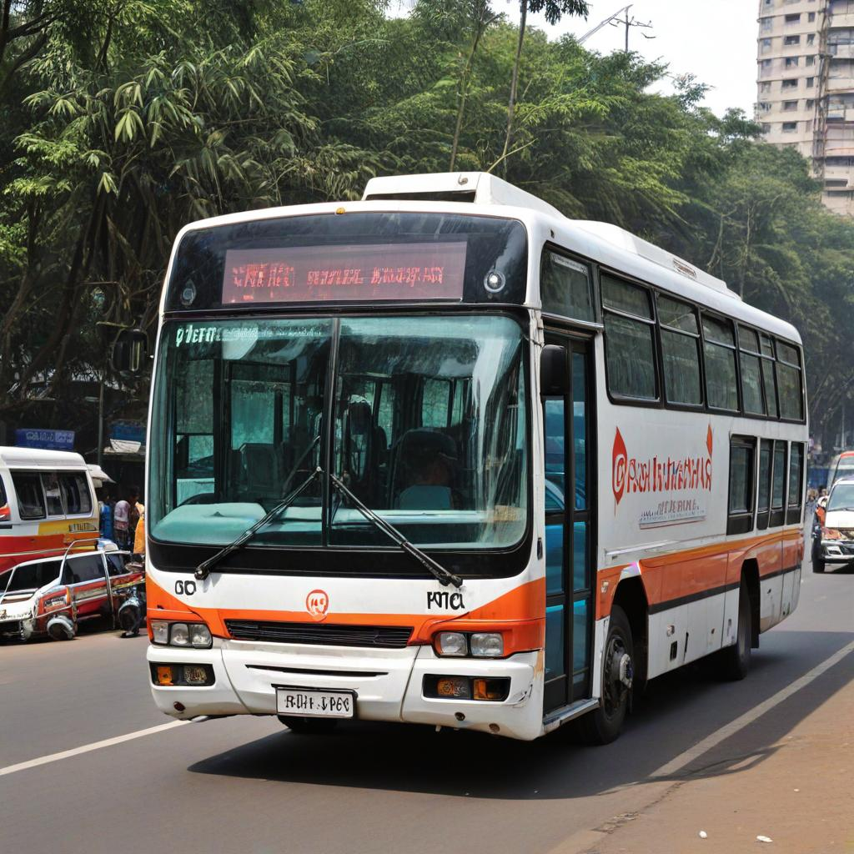
Recommendations - Short Term Measures
The following are the short term measures for reducing road congestion issues due to public transport systems:
Enhance Frequency and Reliability: Increase the frequency of services during peak hours and ensure reliable schedules to improve convenience for commuters.
Upgrade Infrastructure: Maintain and upgrade existing infrastructure such as stations, bus stops, and terminals to ensure safety, comfort, and accessibility for passengers.
Introduce Real-Time Information: Implement real-time information systems at stops and stations to inform passengers about arrivals, delays, and alternative routes.
Promote Integration: Improve coordination and integration between different modes of transport (e.g., buses, trains, bicycles) to provide seamless and efficient transfer options.
Address Accessibility: Ensure accessibility features are in place, such as ramps, elevators, and designated spaces for passengers with disabilities.

Slide 22
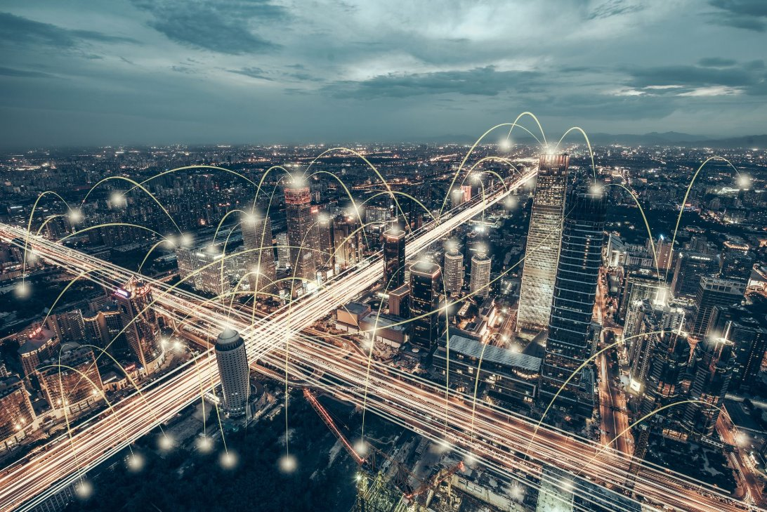
Recommendations - Long Term Measures
Expand Network Coverage: Plan and develop new routes and extensions to reach underserved areas and accommodate growing populations.
Invest in Sustainable Technologies: Introduce eco-friendly transport options such as electric buses and trains to reduce emissions and environmental impact.
Implement Transit-Oriented Development (TOD): Encourage development around transit hubs to create vibrant, walkable communities that reduce reliance on cars.
Prioritize Safety and Security: Implement measures to enhance passenger safety and security, such as surveillance systems and emergency response protocols.
Promote Public Awareness and Usage: Launch campaigns to educate the public about the benefits of using public transport and incentivize its use through fare discounts or subsidies.
Strengthen Governance and Funding: Ensure robust governance structures and secure sustainable funding sources to support ongoing maintenance, upgrades, and expansions.

Slide 23
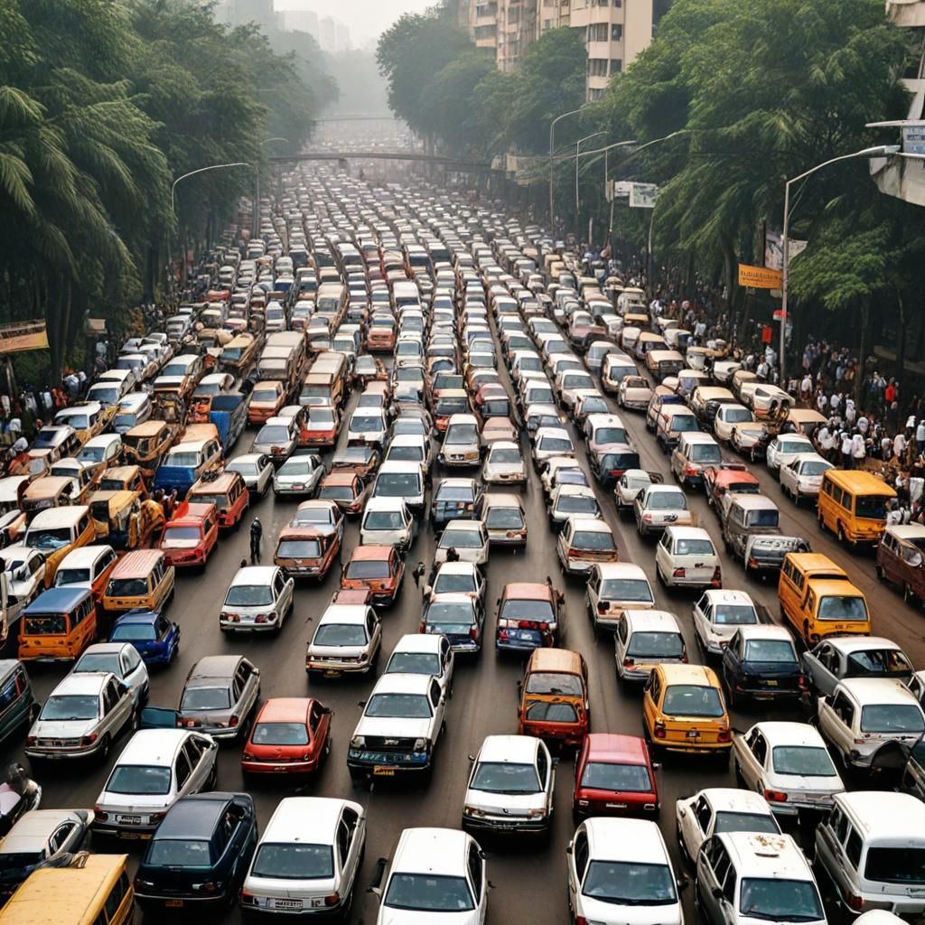
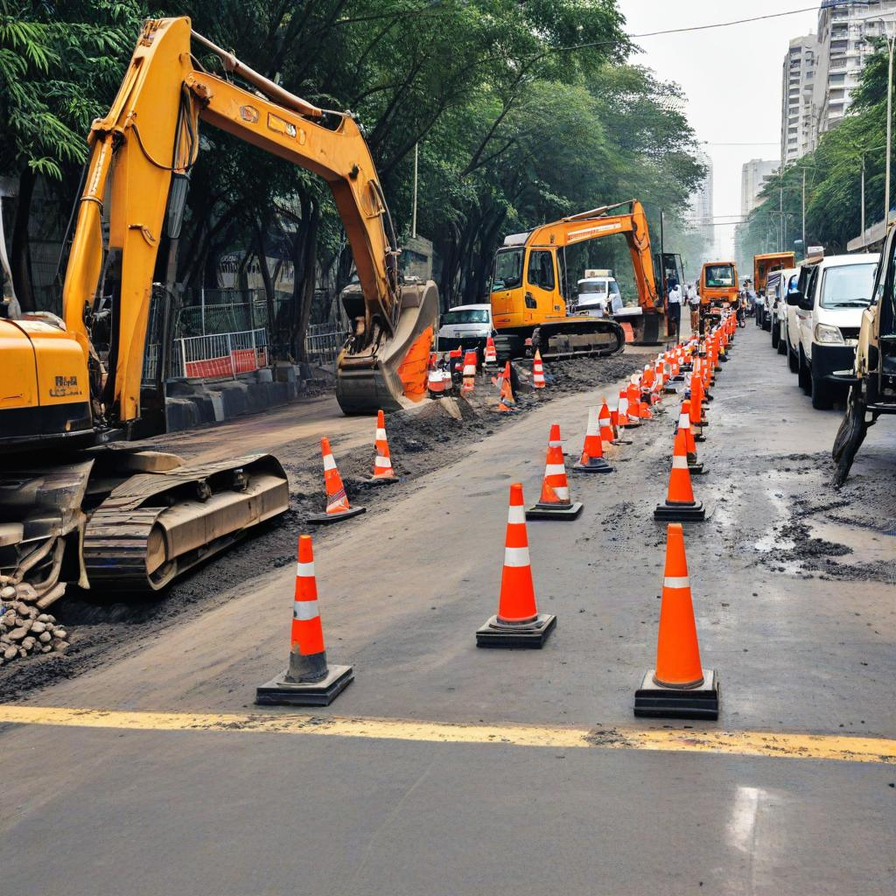
Road Congestion Issues - Poor Road Infrastructure
# Major Causes of Road Congestion in Greater Mumbai
The following are the major causes of congestion issues due to poor road infrastructure:
High Vehicle Density: Greater Mumbai has a high number of vehicles relative to its road capacity.
Insufficient Road Infrastructure: Many roads are narrow, poorly maintained, and not designed to handle the current volume of traffic.
Encroachments and Illegal Parking: Roadside encroachments by vendors and illegal parking reduce the usable road width, causing traffic jams.
Frequent Road Works and Constructions: Ongoing infrastructure projects, utility repairs, and road maintenance works often lead to lane closures and diversions, causing congestion.

Slide 24
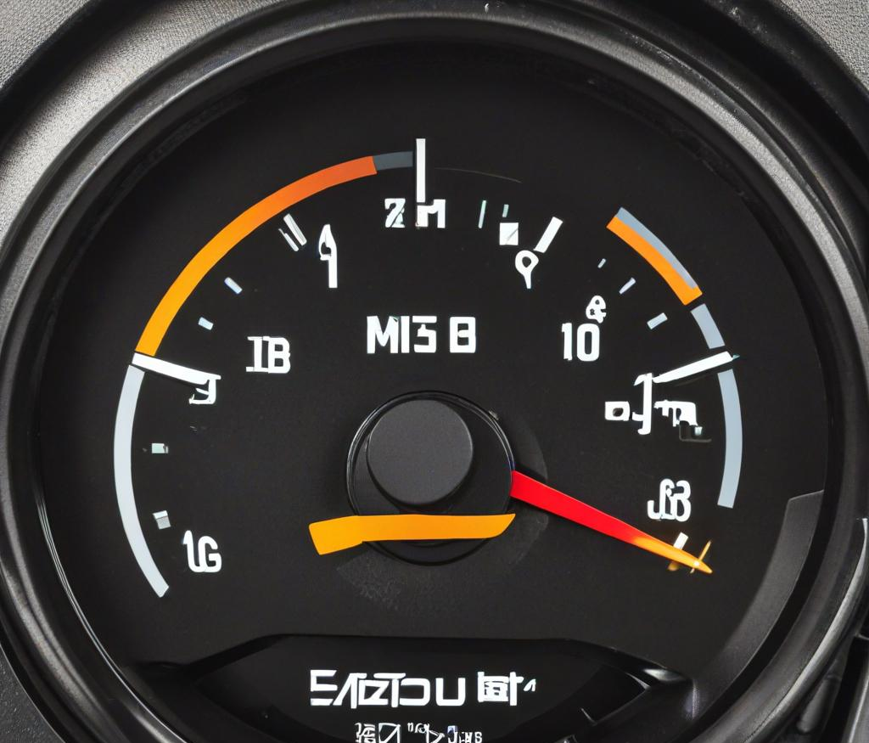
Road Congestion Issues - Poor Road Infrastructure
The following are the major impacts of congestion issues due to poor road infrastructure:
Increased Travel Time: Commuters spend a significant amount of time stuck in traffic, leading to reduced productivity and increased stress levels.
Environmental Pollution: Idling vehicles contribute to higher emissions of pollutants, worsening air quality and contributing to respiratory problems among residents.
Economic Losses: Delays in the transportation of goods and services affect businesses, leading to economic losses.
Higher Fuel Consumption: Stop-and-go traffic leads to inefficient fuel use, increasing costs for vehicle owners and contributing to environmental degradation.

Slide 25
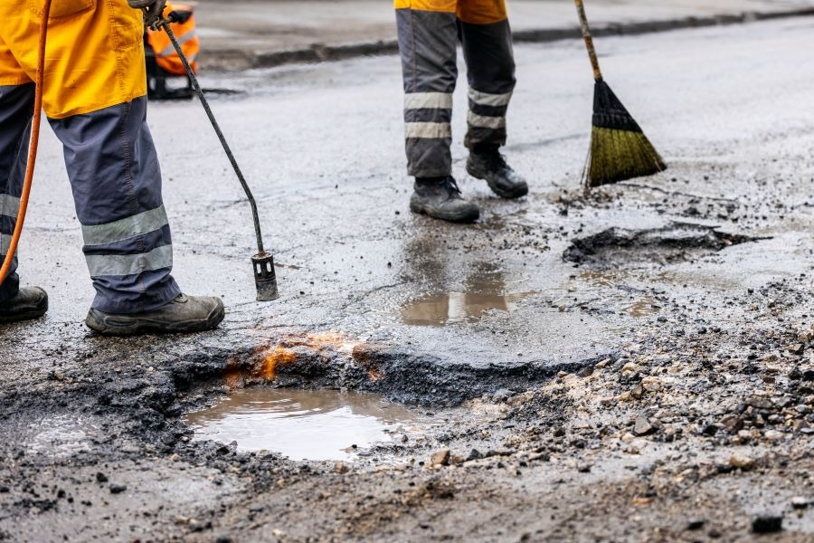
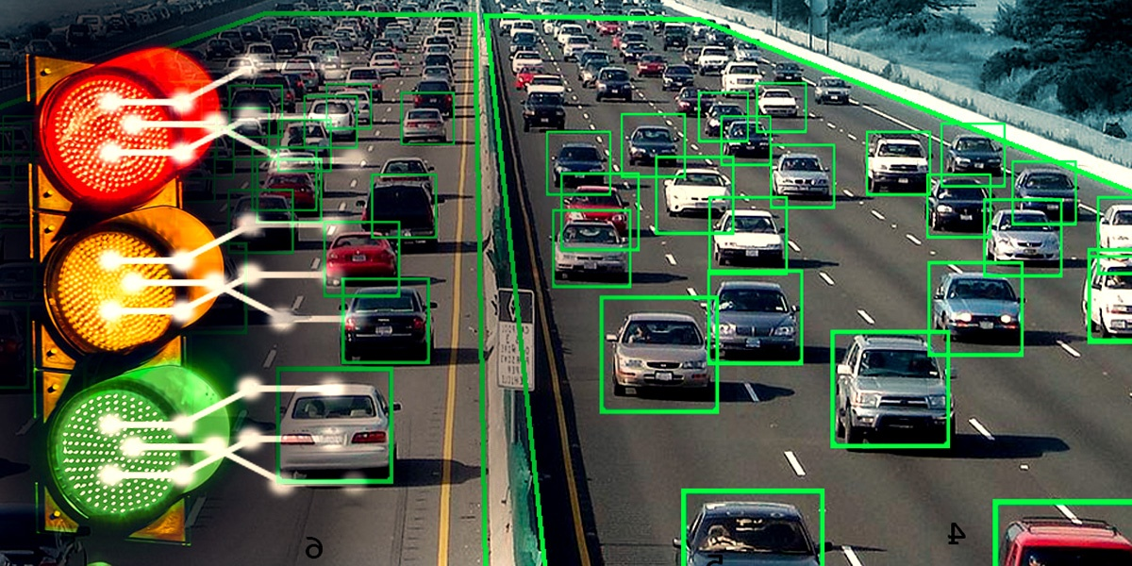
Recommendations - Short Term Measures
The following are the short term measures for reducing road congestion issues due to poor road infrastructure:
Pothole Repair and Road Maintenance: Implement a rapid response system for pothole repairs and regular maintenance schedules to ensure roads are in good condition.
Traffic Signal Optimization: Adjust traffic signal timings based on real-time traffic data to improve traffic flow and reduce waiting times at intersections.
Enhanced Traffic Management: Deploy more traffic police at critical junctions during peak hours and use technology for real-time traffic monitoring and management.
Strict Enforcement of Traffic Rules: Increase penalties for traffic violations such as illegal parking, encroachments, and signal jumping to discourage such behaviors.

Slide 26
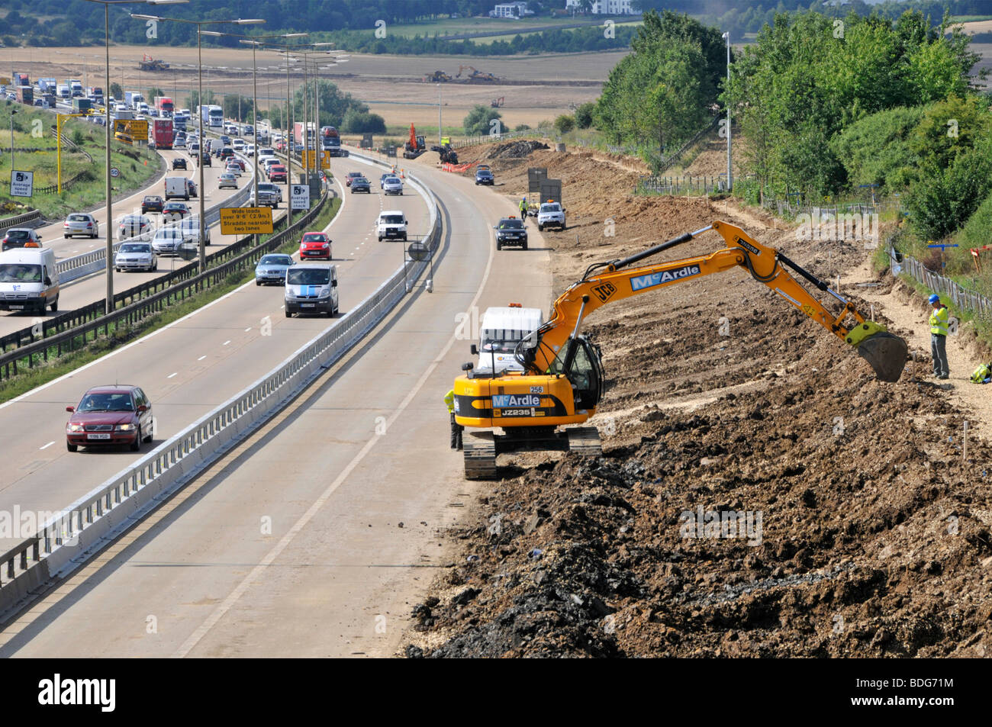
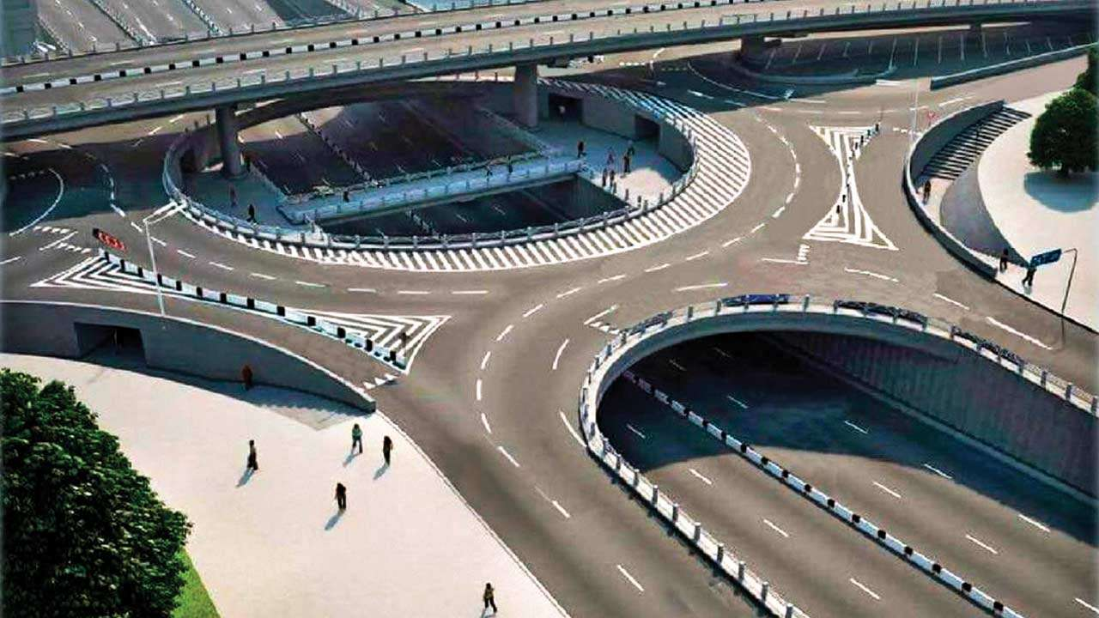
Recommendations - Long Term Measures
Expansion of Road Network
Widen Existing Roads: Where feasible, widen existing roads to accommodate more vehicles.
Construct New Roads: Develop new roadways and flyovers to ease the load on existing ones, especially in high-congestion areas.
Improvement of Public Transportation
Expand Metro and Suburban Rail Networks: Increase the reach and frequency of metro and suburban train services to provide a reliable alternative to private vehicles.
Road Design and Safety Improvements
Modern Road Design Standards: Implement modern road design standards that include proper signage, lane markings, and safety features such as pedestrian crossings and speed control measures.
Flyovers and Underpasses: Construct flyovers and underpasses at critical junctions to ensure smooth traffic flow and reduce congestion.
Infrastructure for New Modes of Transport
Cable Cars and Water Transport: Explore and develop alternative transport modes like cable cars for hilly terrains and water transport for coastal and riverine areas to diversify the transport options.

Slide 27
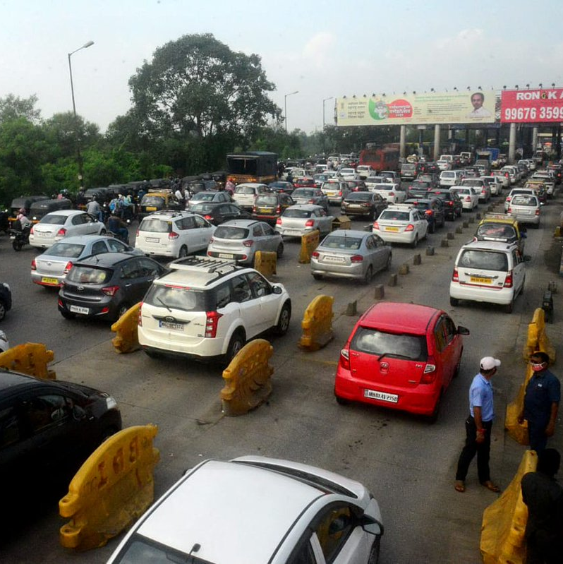
Dynamic Congestion Pricing
Dynamic Congestion Pricing: An innovative traffic management strategy that adjusts toll rates in real-time based on current traffic conditions.
Core Objective: Alleviate congestion by encouraging drivers to modify their travel behavior whether by altering travel times, choosing alternative routes, or opting for different modes of transportation.
Responsive Toll Rates:
Higher rates during peak congestion periods to determine excessive road usage.
Lower rates during off-peak times to encourage road use when traffic is lighter.

Slide 28




Potential Benefits of Dynamic Congestion Pricing
Reduced Traffic Congestion
Increased Revenue for Infrastructure
Improved Air Quality
Enhanced Public Safety
Dynamic pricing incentivizes drivers to travel during off-peak hours, alleviating congestion during peak periods.
The revenue generated from congestion pricing can be used to fund improvements to public transportation and infrastructure.
Dynamic pricing promotes public transit and carpooling to cut emissions and clean the air.
Reduced traffic congestion can lead to shorter commute times and fewer accidents, resulting in improved public safety.

Slide 29
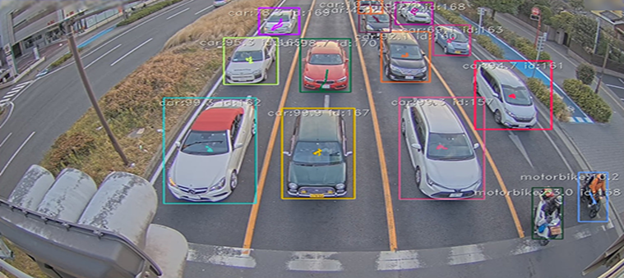
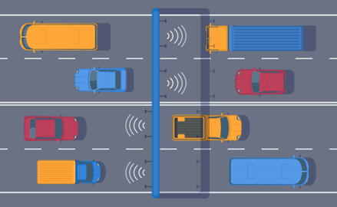
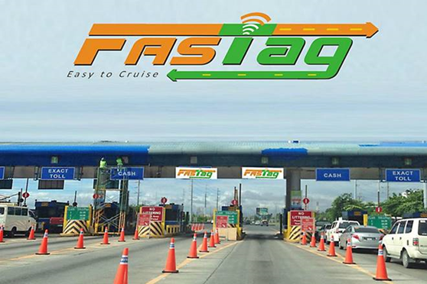
Implementing Dynamic Congestion Pricing
Real-Time Data Collection
Deploy a network of traffic sensors, GPS tracking, and transit data feeds to continuously monitor traffic patterns and congestion levels across the city.
Flexible Pricing Algorithm
Develop an algorithm for dynamic toll rate adjustment based on real-time demand and time of day, leveraging advanced methods like Dijkstra's algorithm to optimize traffic flow by identifying shortest and least congested routes.
Seamless Digital Payment
Implement a user-friendly mobile app and digital payment system that allows commuters to seamlessly pay tolls and access real time data on pricing and travel options.

Slide 30
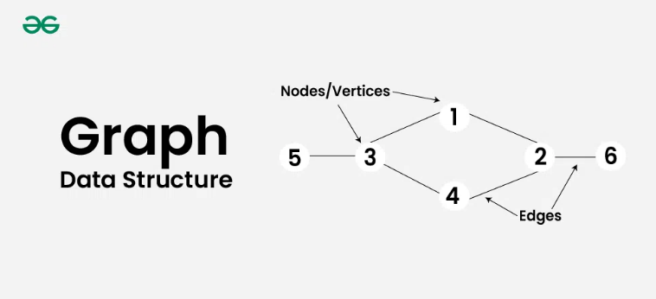
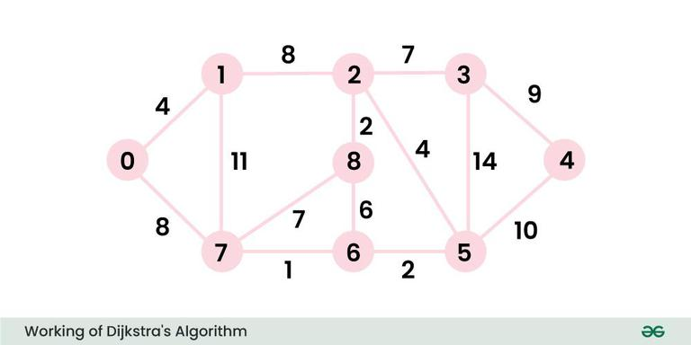
Dijkstra's Algorithm - Dynamic Congestion Pricing
We can set the dynamic prices for the toll taxes on the basis of congestion by using a popular algorithm which is called as Dijkstra's Algorithm.
The Dijkstra's algorithm is based on graphs which is one of the important data structures in programming.
First of all, let's understand the basic terminology in graphs and move on to how this algorithm is useful in setting the dynamic prices.
Vertices: Vertices are the fundamental units of the graph. Sometimes, vertices are also known as vertex or nodes. Every node or vertex can be labeled or unlabeled.
Edges: Edges are drawn or used to connect two nodes of the graph. Edges can connect any two nodes in any possible way. There are no rules. Sometimes edges are also known as arcs. Every edge can be labeled or unlabeled.
Weights: If the edges are labeled and if there are some numbers near the edges, then the numbers are known as weights. It adds a significant value to the edges in the graph.
Credits: Geeks for Geeks

Slide 31
Dijkstra's Algorithm - Dynamic Congestion Pricing
For our ease of understanding, let's assume the following:
The vertices represents the different places where toll gates are located.
The edges represents the different routes from different places or locations.
The weights represent the weighted mean of distance, traffic on a scale of 0-15.
Vertices
Weights
0
3
5
8
2
Edges
4
9
1
4
GitHub Repository Link: Dijkstra's Algorithm

Slide 32
Dijkstra's Algorithm - Dynamic Congestion Pricing
Generally, we use Dijkstra's algorithm for finding the sum of weights of shortest path between a source node and the other nodes. (i.e. the sum of the weights should be min.)
As the weights here are the weighted means of the distance, traffic on a scale of 0-15, we can find out the best route or the most efficient route on the basis of traffic and distances. The dynamic prices can also be set as well by identifying the congestion routes.
0, 4, 12, 19, 21, 11, 9, 8, 14 4, 0, 8, 15, 22, 12, 12, 11, 10 12, 8, 0, 7, 14, 4, 6, 7, 2 19, 15, 7, 0, 9, 11, 13, 14, 9 21, 22, 14, 9, 0, 10, 12, 13, 16 11, 12, 4, 11, 10, 0, 2, 3, 6 9, 12, 6, 13, 12, 2, 0, 1, 6 8, 11, 7, 14, 13, 3, 1, 0, 7 14, 10, 2, 9, 16, 6, 6, 7, 0
A shortest path matrix which represents the lowest weighted mean between two nodes or vertices.
For example, the element in the 5th row and 6th column represents (i.e. 10) the lowest weighted mean between the nodes 4 and 5. The lowest weighted mean represents the best route or the most efficient route between two locations.

Slide 33


Potential Risks & Mitigation Methods
Equity Concerns
Accessibility: Higher tolls during peak times can disproportionately affect
lower-income drivers.
Equitable Solutions: Implementing discounts or subsidies for low-income
commuters and improving public transport options can mitigate equity issues.
Public Acceptance
Resistance to Change: Drivers may resist new tolls or variable pricing structures.
Awareness Campaigns: Effective communication and public awareness campaigns are essential to explain the benefits and workings of dynamic congestion pricing.
Technological and Operational Costs
Infrastructure Investment: Significant investment in technology and infrastructure is required to monitor traffic and collect tolls efficiently.
Operational Management: Continuous management and adjustment of toll rates necessitate robust systems and skilled personnel.
Data Privacy
Monitoring Systems: Continuous tracking of vehicles raises concerns about data privacy and security.
Regulatory Measures: Implementing strict data protection and privacy regulations is essential to address these concerns.

Slide 34
Thank You!!

